Slide 1
Programming assignment-2
PRASHANTH KANDHURI

Slide 2
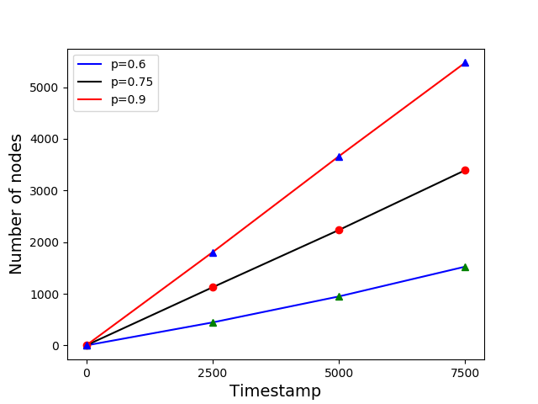
Fig 2 of paper

Slide 3
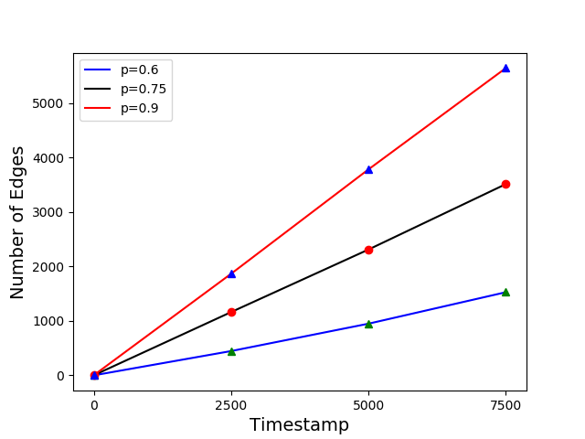
Fig 3 of paper

Slide 4
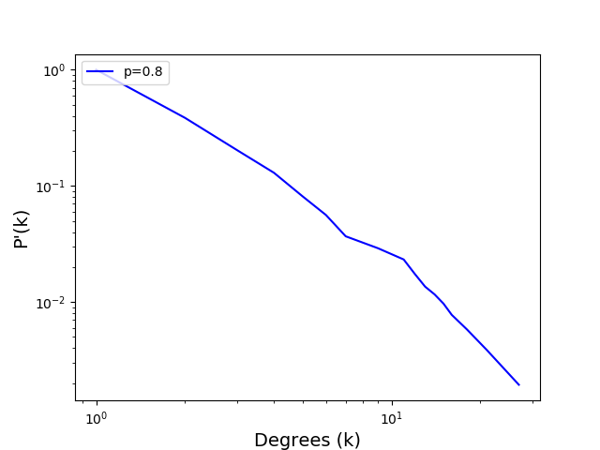
Fig 5 of paper

